Slide 1
STUDENT PORTFOLIO

Slide 2
GITHUB LINK

Slide 3
ABOUT ME
NAME-B.Sanjima
COURSE-Bsc.computer science
COLLEGE NAME-Valliammai Women’s College for Arts and Science
EMAIL ID-babu.akn.bs@gmail.com
Ph.no-9095752277

Slide 4
TABLE OF CONTENTS
Self introduction
Academic information
Skills
Projects
Achievement
Extracurricular activities
Internship experience
Personal details
Conclusion

Slide 5
SELF INTRODUCTION
My name is sanjima ,a student of the second year bachelor of computer science with a passion of the learning programmes to have job in the software companies that may help us to develop many software applications. The applications are very useful to the people.i learned about python, c++,data structure and algorithm programming. My career goal is to become a web developer and work on innovative technology projects

Slide 6
ACADEMIC INFORMATION
Bsc. Computer science:
2024-2027(Valliammai women’s college for arts and science )=80%
Higher Secondary:
2022-2024(Government Higher Secondary school)=75%
SSLC:
2021-2022(Government Higher secondary school)=89%

Slide 7
SKILLS
TECHNICAL SKILLS:
Programming language:c++,python
Web development:HTML,CSS,Javascript
Tools: ms excel
Time management
Problem solving
Leadership
Teamwork

Slide 8
ACHIEVEMENTS
Received merit scholarship for Scoring above 80% in all semesters

Slide 9
EXTRACURRICULAR ACTIVITIES
Creative pursuits-arts, music, writing or other Creative activities
Sports- team sports ,individual sports
Cultural events- organizing or participating

Slide 10
PERSONAL DETAILS
Date of birth:13/03/2007
Language known:tamil,english
Hobbies and interest:reading books, playing, cooking, drawing, coding...

Slide 11
CONCLUSION
“I am enthusiastic learner with strong technical and communication.my future aspiration is to work in a reputed IT company as a software developer and later pursue higher studies in artificial intelligence. Iam confident that my skills ,projects and dedication will help me achieve my goals “

Slide 12
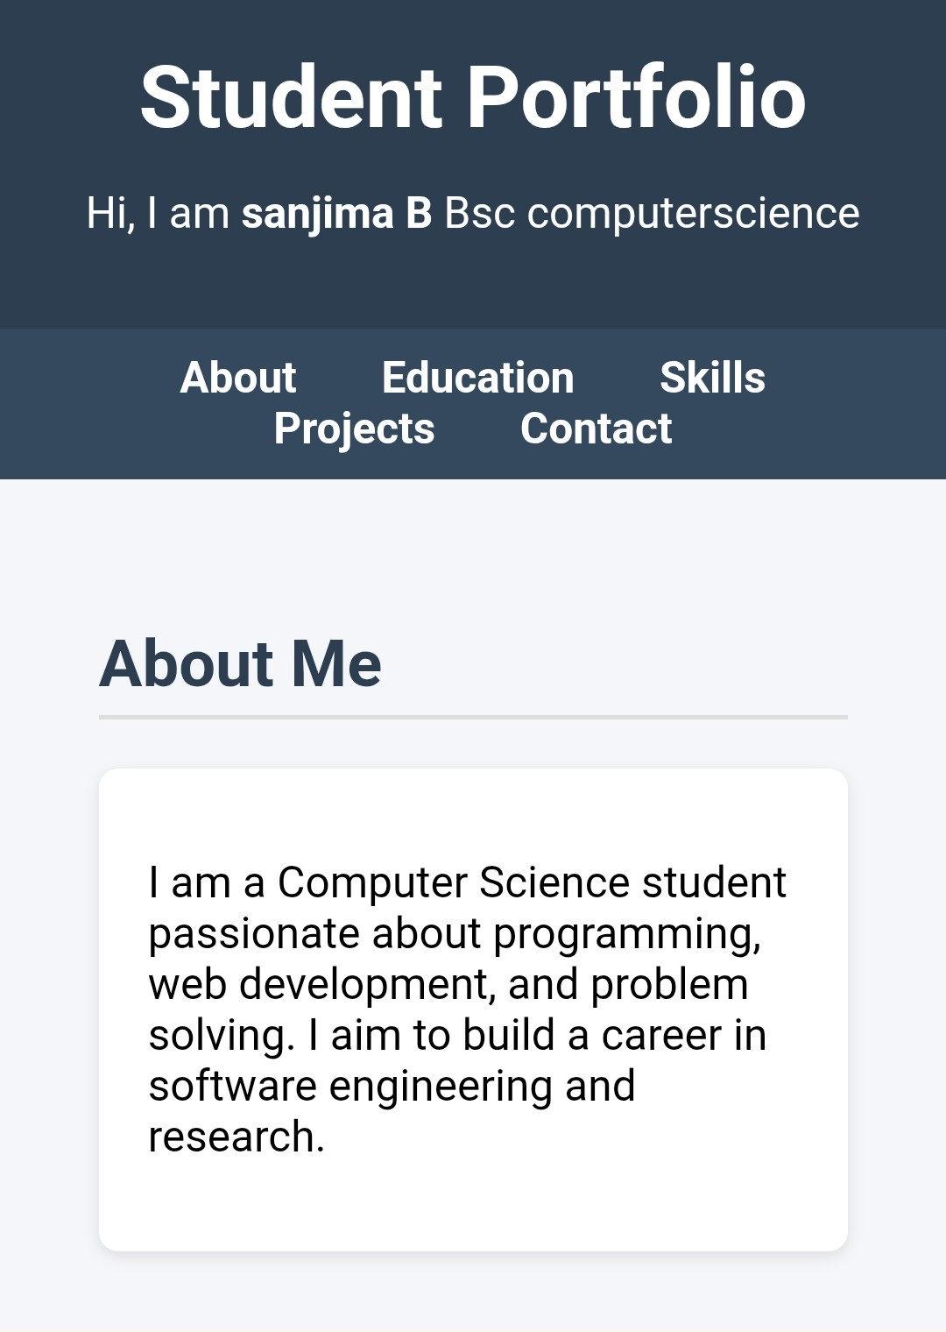

Slide 13
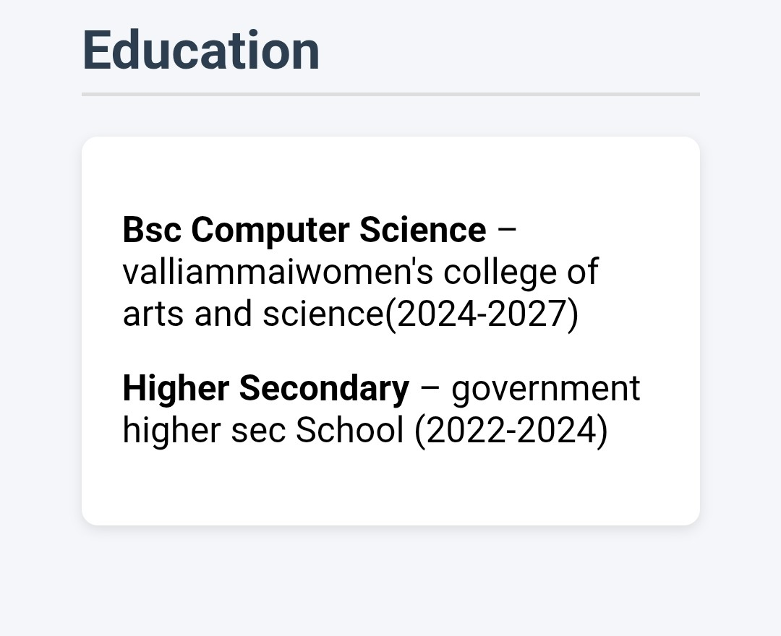

Slide 14
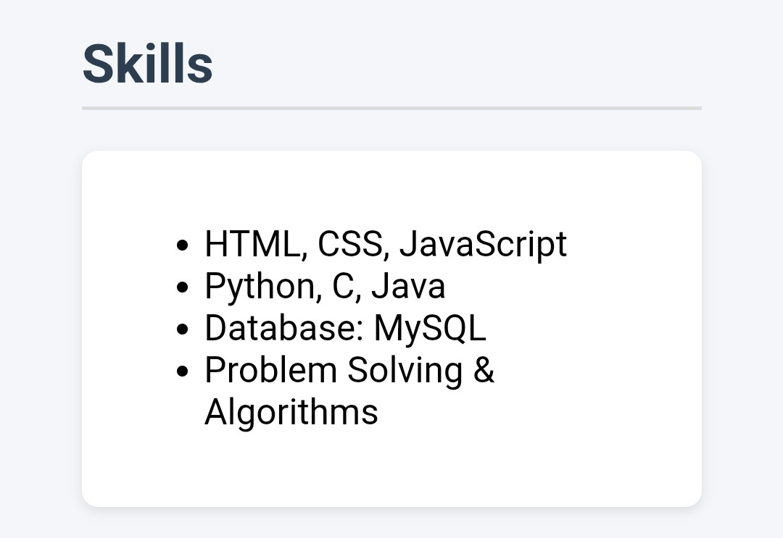

Slide 15
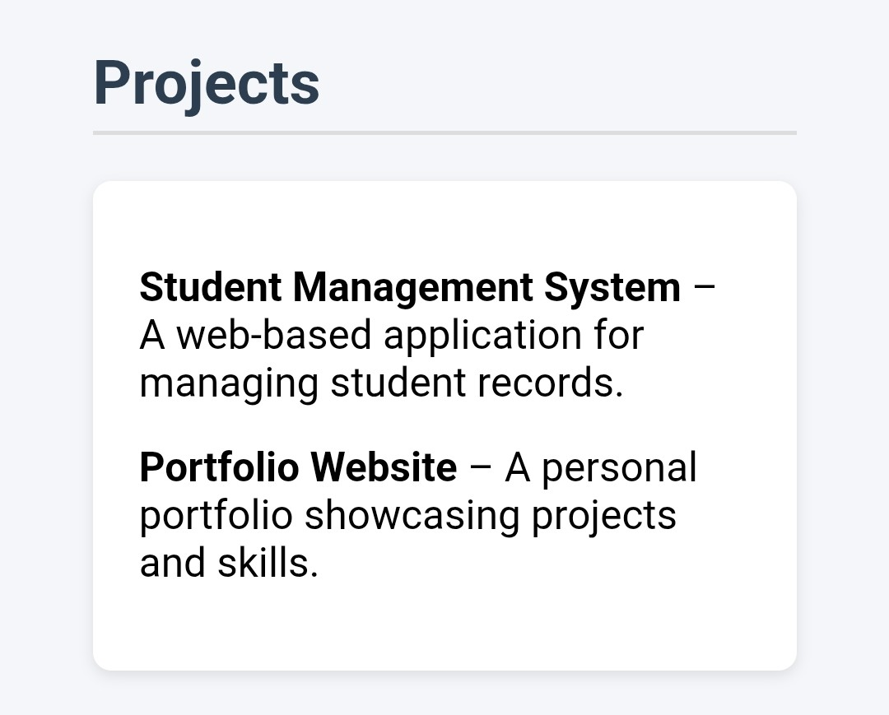

Slide 16
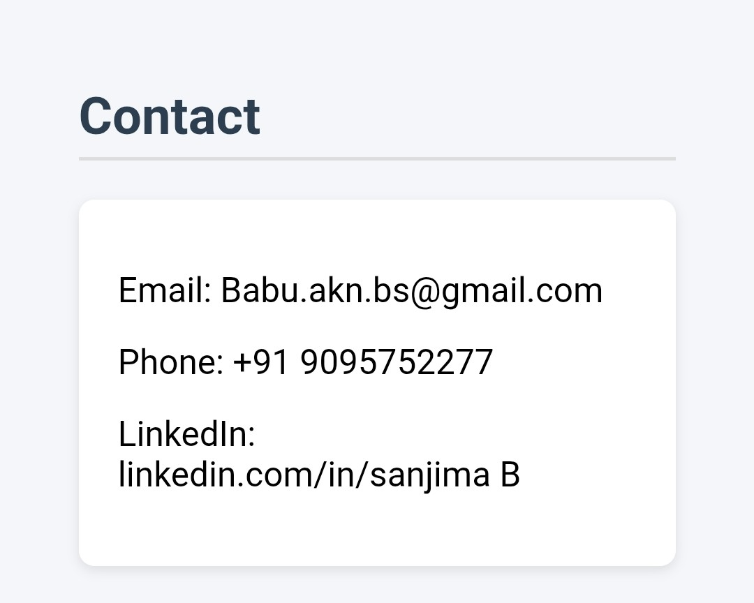

Slide 17
GITHUB LINK
https://github.com/sanjima2007

